Slide 1





TextEvolve
Digitizing History with AI/OCR
Team Name
:
Dynamic Dreamers
NMNT ID
:
NMNTSTD7116020
College Name
:
Kathir College of Engineering

Slide 2
Problem Statement
Theme:
Artificial Intelligence
Problem Statement:
How might we develop an AI or OCR solution to digitize and convert handwritten, old registered documents into a readable and accessible format in regional languages, improving public access and readability of historical records? The solution should allow the output to be downloaded in various formats such as PDF and Word, enabling wider distribution and accessibility.

Slide 3
Existing System and Proposed System
Existing System:
Traditional methods of digitization are slow and prone to errors.
Manual transcription is time-consuming and expensive.
Existing OCR models have limited accuracy for handwritten and regional texts.
Lack of language diversity and support for historical scripts.

Slide 4
Existing System and Proposed System
Proposed System:
AI-driven OCR solution for handwritten and regional languages.
Combines a custom ML model with Google OCR API for improved accuracy.
Fast, scalable, and easy-to-use platform with real-time results.
Secure data storage and enhanced accessibility.

Slide 5
References
Google OCR API: For high-accuracy text extraction.
TensorFlow, PyTorch, Keras: For building and training the ML model.
MongoDB: For flexible and scalable document storage.
Flask: For backend service and API integration.
React Vite & Tailwind: For responsive and fast UI.

Slide 6
Innovative and Unique Solution
Custom ML Model:
Designed specifically for handwritten and regional scripts.
Improves recognition accuracy over time with continuous training.
Dual OCR Integration:
Custom model for initial recognition.
Google OCR API for enhanced accuracy and corrections.

Slide 7
Innovative and Unique Solution
Language Versatility:
Language Versatility
Robust Data Handling:
Python Flask backend paired with MongoDB ensures scalable and secure storage.
User-Friendly Platform:
Modern UI for easy upload and retrieval.
Real-time results and progress tracking.

Slide 8



















Technology Stack
Programming Languages
Database & Deployment
Frameworks & Libraries
Development Tools

Slide 9


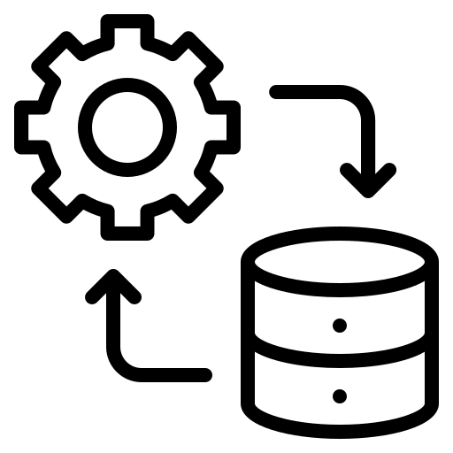

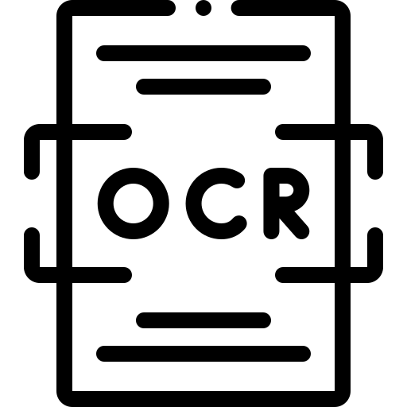
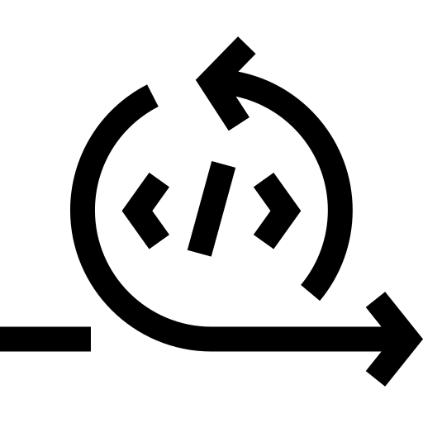






System Architecture & Workflow
Model initial conversion
User Access
Save successful?
Data Integration
Pre-processing
OCR Conversion
Re-run ML model
Post-Processing
Storage
Results
Error
OCR API
Notify error

Slide 10

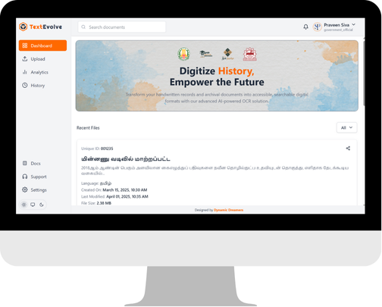
Demo / Sample Results
https://squadofcreators.github.io/TextEvolve

Slide 11
Challenges
Degradation:
Physical documents deteriorate over time.
Inaccessibility:
Limited access to rare or regional texts.
Handwriting Variability:
Handwritten texts present difficulties in standard OCR processing.
Language Barriers:
Many OCR solutions are not optimized for regional languages.

Slide 12
Benefits & Impact
Cultural Preservation: Safeguard historical documents for future generations.
Enhanced Accessibility: Allow researchers, educators, and the public to easily access digitized content.
Improved Research: Facilitate the study of regional languages and historical texts.
Scalability: A robust system that can grow to handle vast archives.

Slide 13
Conclusion
TextEVolve is an AI-driven solution that digitizes handwritten historical documents with high accuracy using a custom ML model and Google OCR API.
By combining innovation with technology, it preserves cultural heritage, enhances accessibility, and supports research — ensuring valuable historical knowledge is safeguarded for future generations.

Slide 14
Q&A
?
Ask Questions

Slide 15

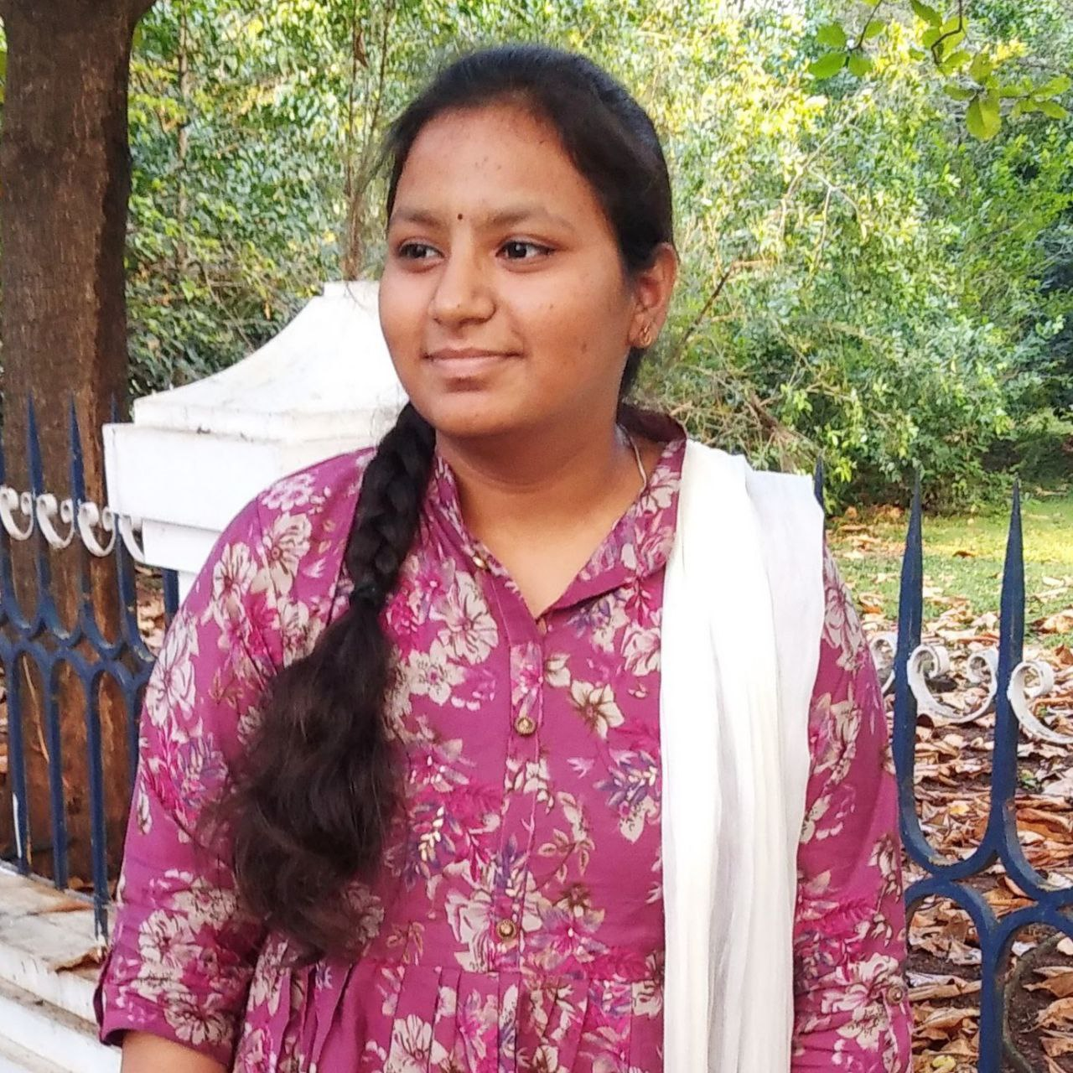



Our Team
Mrs. Kavitha M
Yuva Nandhini M
Faculty Guide
AI/ML Developer
Praveenkumar S
Sibi Siddharth S
Uma Maheswari P
AI/MERN Developer
AI/MERN Developer
AI/ML Developer

Slide 16
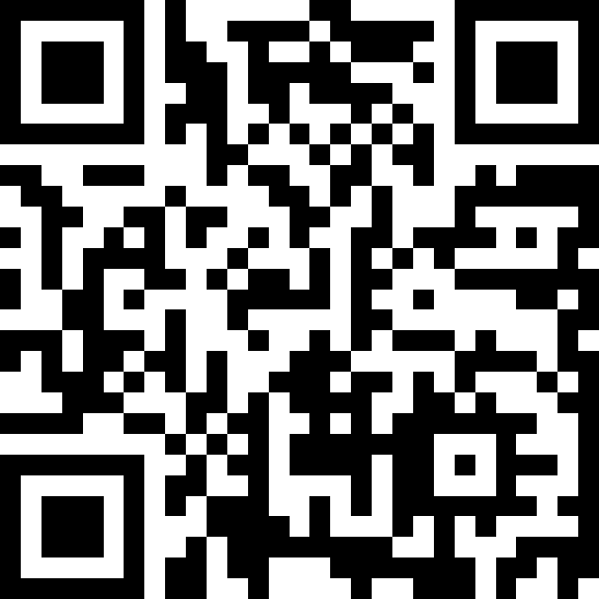
Live Project
Preserving the Past, Empowering the Future

